Slide 1
What is a resume?
A resume is a personal summary of your professional history and qualifications. It includes information about your career goals, education, work experience, activities, honors, and any special skills you might have.

Slide 2
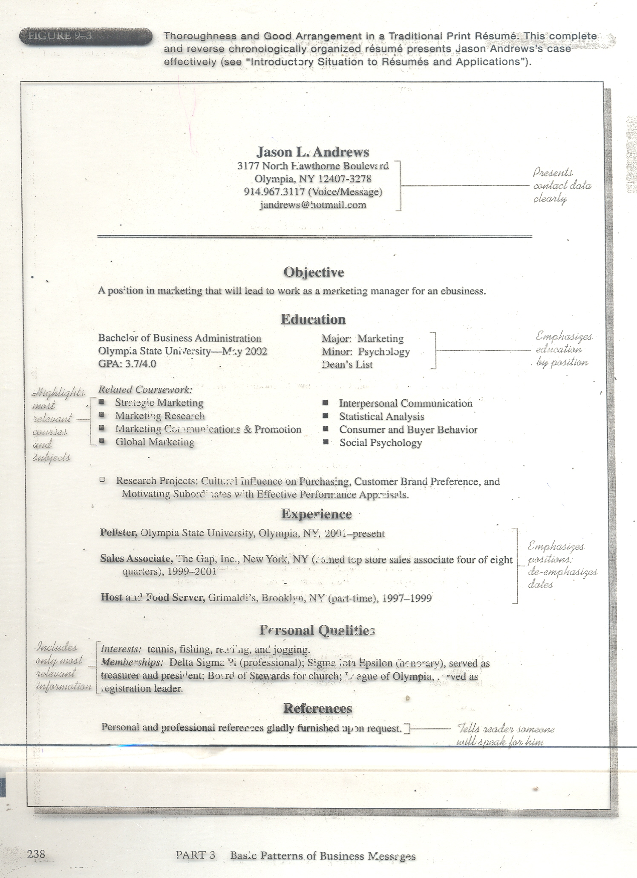

Slide 3
Sections of a Resume

Slide 4
The Header
What should be included?
  Name
  Permanent and present address
  E-mail address
  Telephone number

Slide 5
The Header
Rahul K. Sharma
1234,Nowhere Street
New Delhi 1
98151100000
rahulsharma@gmail.com

Slide 6
Career Objective Statement
  Purpose: To Communicate the type of position you are interested in.
  Be direct and specific and avoid vague statements
To apply for an entry level position in XYZ limited looks quite general and narrow.
To apply my engineering skills and academic experience in a large, well placed firm which offers the potential for career advancement to senior management ranks.

Slide 7
Objective Statement
Do not use personal pronouns.
I want to work with a reputed company in the sales position.
To obtain a sales position with a reputed brand name.

Slide 8
Rahul K. Sharma
1234,Nowhere Street
New Delhi 1
98151100000
rahulsharma@gmail.com
OBJECTIVE: To obtain an entry-level position as a trainee engineer with ABC Technologies (use the name of the organization), allowing me to utilize my education and internship experience while gaining valuable work experience in a team oriented environment.

Slide 9
Education
List degrees in reverse chronological order
  Most recent degree is listed first
Name of Institution
  Include city and state if not part of the title
Name of your degree and GPA.
  9.5 GPA in B.Tech from Thapar Institute of Engineering and Technology, Patiala 2022.
  OR
  Graduate Engineer from Thapar Institute of Engineering and Technology with 7.2 GPA,2022.

Slide 10
Rahul K. Sharma
1234,Nowhere Street
New Delhi 1
98151100000
rahulsharma@gmail.com
OBJECTIVE: To obtain an entry-level position as a Mechanical Engineer with ABC Technologies, allowing me to utilize my education and internship experience while gaining valuable work experience in a team oriented environment
EDUCATION: 3.9/5 GPA in MSc in Molecular Biology, Columbia University, New York, NY(2015–2018)
Favorite fields of study: Molecular Biology and Genetics, The RNA World: A Functional and Computational Analysis, Cancer Cell Biology, Immuno-biology
Achievement: President of the graduate student board 2015–2016
Started and oversaw a volunteer research project investigating human evolutionary genomics.
BSc in Biology, Penn State, Philadelphia, PA Bachelor of Fine Arts, Cornell University, Cum Laude New York City, NY( 2013–2015)
Achievements: Recipient of College colour in 2013.

Slide 11
Experience
Job title.
Name of the company.
City/country.
Dates of employment.
Company description
Brief description of your job responsibilities.
Your key achievements/accomplishments.

Slide 12
Listing Responsibilities
Use bullet points
Start each line with an action verb
  Present tense if currently employed
  Vary your choice of verbs
Tailor skills and experiences to the position for which you are applying
Be concise

Slide 13
Experience
Apprentice Engineer 2018-2019
The University of Texas M. D. Anderson Cancer Center, Leukemia Research Team
Maintained and established software lines
Identified potential areas of growth in the technical areas.
Collaborated for key projects with the agencies.
Key achievements: Introduced a new standard operating procedure for monitoring inventoriess to increase efficiency by 33%.

Slide 14
Experience
Undergraduate Teacher Assistant 2016-2018
Columbia University
Conducted deep research into 15 unique project topics as directed by professors. Commended by 3 professors for quality of research.
Graded papers for two years, approximately 800 papers graded.
Performed regular data entry tasks on student project grades.
Provided feedback and guidance to 100+ students.

Slide 15
Achievements/Awards
Try to list things that may be related to the job profile
Make sure your contents are accurate
Do not clutter the section
Use action words like; developed, designed, fabricated, accomplished etc.
In case of a group award, please state your contribution and role in the group.

Slide 16
Hobbies and Interests
Keep it short and to the point (maximum 2-3 lines)
Be specific
Don’t list down your interests – describe them in sentences!
Keep it real and don’t exaggerate.

Slide 17
References
Full name
Designation
Affiliation
Email id
Phone number

Slide 18
Putting It All Together…
Things to Remember
Avoid stating salary requirements
Avoid limiting geographical considerations (unless necessary)
Tailor your resume for the job you are applying for
Avoid expounding on philosophy or values
Avoid offering any negative information
Check for grammatical, spelling & typing errors

Slide 19
Putting It All Together…
Things to Remember
Attract & hold your reader’s attention
  Combinations of capital lettering, underlining, bold face type, and indentations can jazz up your paper
Whatever format you choose, be sure to be consistent
Laser print on resume paper
Be absolutely honest

Slide 20
Remember
A resume does not get you a job…
A resume does get you an interview.
And, putting time and consideration
into your resume is one of the
best ways to prepare for your interviews!

Slide 21
Cover Letter
A cover letter is the mouthpiece of the resume
Use it to market yourself
Your interests in joining the organization
Emphasise your plus points both in experience and academics
Close with a strong reinforcing statement
Use a formal style of salutation

Slide 22
Sioux City, IA 51104
January 5, 2021
Ms. XYZ
Director
ABCD Corporation
1 Dynamics Avenue
Minneapolis, MN 55436
Dear Mr./Ms. LastName,
I am writing to apply for the position of Media Relations Manager. ABCD is a fast-moving global institution and an outstanding communications pioneer, now poised to guide the direction of print journalism.
As a recent graduate of the State University with significant experience in finance, administration and media, I bring the energy and commitment to excellence necessary to thrive in ABCD's innovative environment.
As the current Media Relations Coordinator of the XYZ company, I am a practiced business liaison and an able administrator. These strengths, combined with deep and varied employment and internship experience as a journalist and media consultant with FGH and LMD, prepare me to make a strong and immediate impact at ABCD.
I am excited about the opportunity to join the ABCD team as it moves to the center of the print media conversation. Thank you for your time and consideration.
Sincerely,
Your Signature
“Enclosed: Resume”

